Slide 1
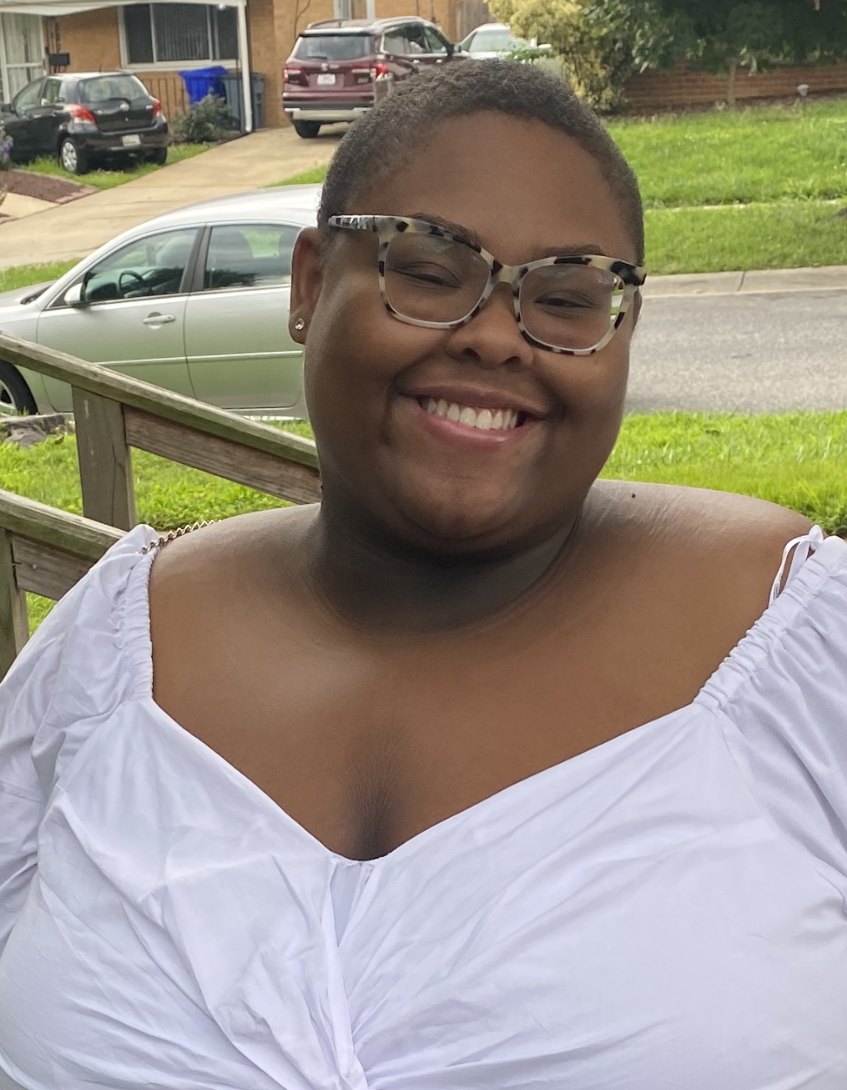
Hello 1st Graders! I am so excited to be be your new teacher for the 2022-2023 academic school year. Our year is going to be filled with excitement and learning and I am so happy to get to be apart of it all! I am looking forward to a magical year!
I am from Maryland, and I have lived here in north Carolina for 10 years now! I went to North Carolina A&T for my undergrad and High Point University for graduate school!
I am very close with my family and love spending my free tine with them!
I have 3 brothers and 1 sister!
Ms. Curry
Here are a few of my favorite things!
Animal: Giraffe or Elephant
Hobby: Painting
Favorite Color: Orange
Food: Sushi, Chinese food, and pizza!
Drink: Lemonade, fruit punch, and starbucks.
Items that I love: Mugs, Chocolate, Gift Cards, anything that’s the color orange!
Phone: 336-316-5888
Email: Currym2@gcsnc.com

